Slide 1

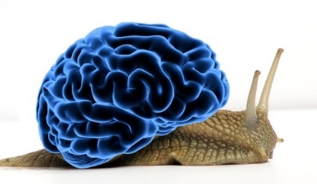
How to deal with physiological noise in fMRI
By
Michalis Kassinopoulos

Slide 2
Outline
Principles of functional magnetic resonance imaging (fMRI)
Sources of physiological noise in fMRI
Correcting for high-frequency cardiac and respiratory artifacts (RETROICOR)
Correcting for low-frequency fluctuations due to changes in heart rate and breathing pattern

Slide 3
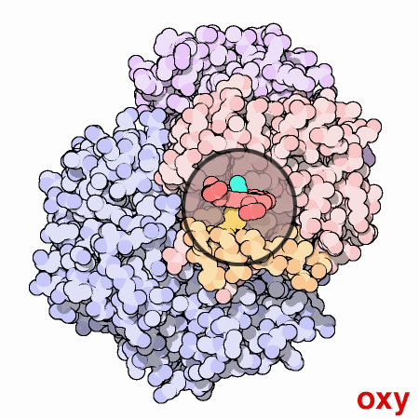
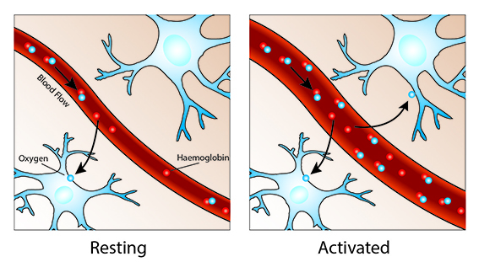
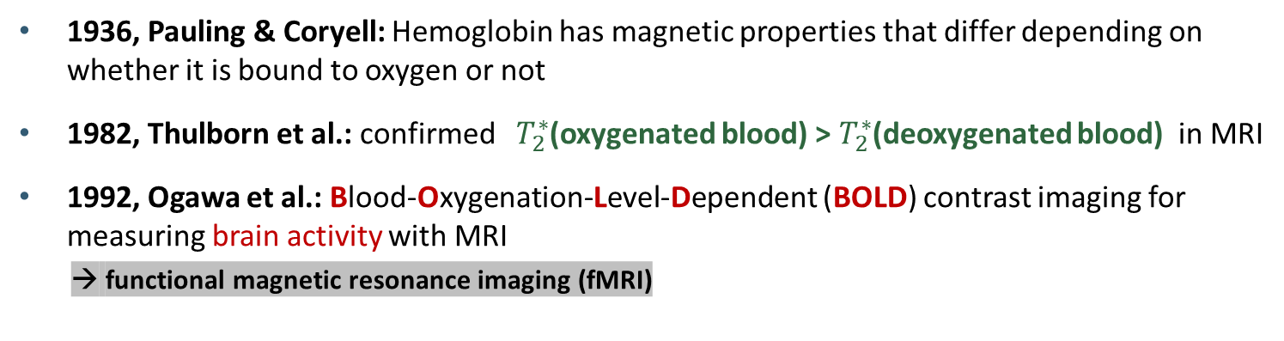
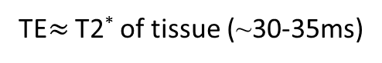
Principles of functional magnetic resonance imaging (fMRI)
1936, Pauling & Coryell: Hemoglobin has magnetic properties that differ depending on whether it is bound to oxygen or not
1982, Thulborn et al.: confirmed $T_{2}^{∗}$(oxygenated blood) > $T_{2}^{∗}$(deoxygenated blood) in MRI
1992, Ogawa et al.: Blood-Oxygenation-Level-Dependent (BOLD) contrast imaging for measuring brain activity with MRI
→ functional magnetic resonance imaging (fMRI)
(Mader, 2004)
neural activity ➔ ↑ blood flow ➔ ↑ oxyhemoglobin ➔ ↑ T2* ➔ ↑ MR signal
TE$≈$ T2* of tissue (~30-35ms)
(Hannah, Stuart, & Irene, 2017)
M_{xy}
Signal
M_{o} sinθ
T₂* oxy
T₂* deoxy
S_{oxy}
S_{deoxy}
ΔS
TE_{optimum}
time
(MRIQUESTIONS.com, 2017)

Slide 4
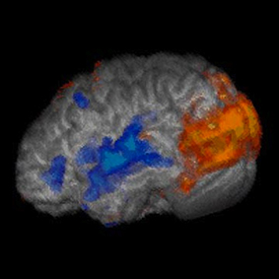
Linear framework for fMRI analysis
*
Hemodynamic response function (HRF)
Activation map for a visual stimulus
=

Slide 5
Resting-state functional connectivity
Resting-state networks (RNSs): regions with correlated spontaneous activity
Functional Connectivity (FC) may reflect:
Neuronal activity
Noise related to head motion (check my poster on HBHL research day for how to deal with head motion in fMRI)
Physiological processes (e.g. cardiac pulsation and respiration)
Fox et al. 2005
Default mode network (DMN)
Dorsal attention network (DAN)

Slide 6
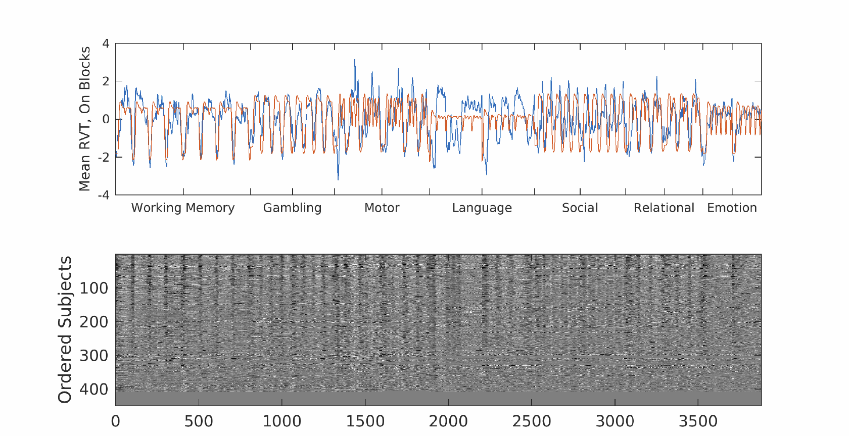
Strong correlation of respiratory variable RVT w/ task-based fMRI data
(Glasser et al. 2018)

Slide 7
Physiological Noise in fMRI
Levels of deoxyhemoglobin
Neuronal activity
CBF
BOLD
Arterial blood pressure
Blood vessel volume
Levels of carbon dioxide (CO2)
~ 0.1 Hz
Breathing pattern (depth & rate)
~ 0.1 Hz
Heart rate
~ 0.1 Hz
Cardiac pulsatility
~ 1 Hz
Respiratory-related thoracic movement
~ 0.3 Hz
Magnetic field

Slide 8
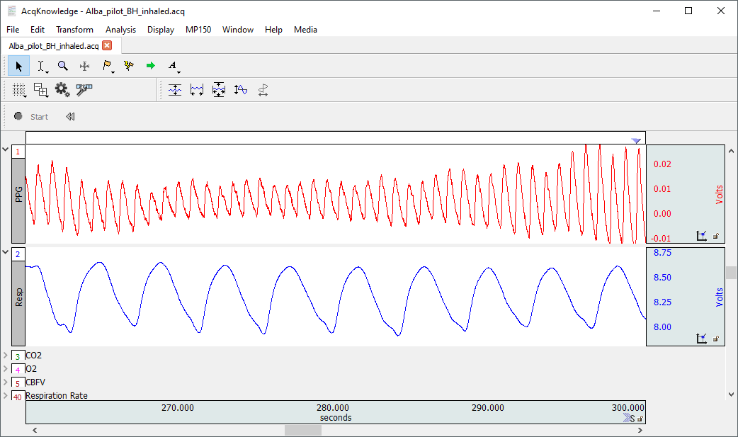
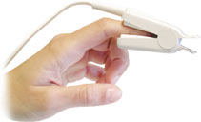
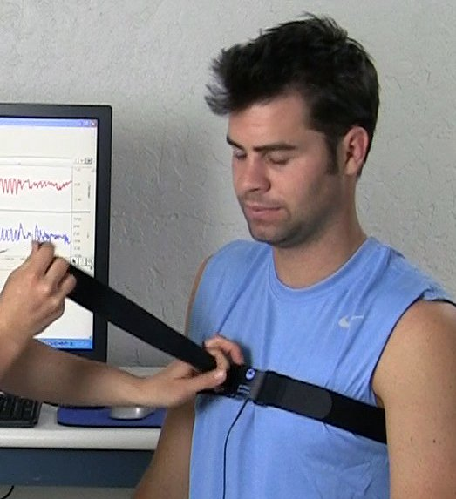
Recording of concurrent physiological processes
~1 Hz
~0.2-0.3 Hz

Slide 9
Physiological Noise in fMRI
Levels of deoxyhemoglobin
Neuronal activity
CBF
BOLD
Arterial blood pressure
Blood vessel volume
Levels of carbon dioxide (CO2)
~ 0.1 Hz
Breathing pattern (depth & rate)
~ 0.1 Hz
Cardiac Response Function (CRF; Chang et al., 2009)
Respiration Response Function (RRF; Birn et al., 2008)
Physiological Response Functions (PRFs; Kassinopoulos & Mitsis, 2019)
Heart rate
~ 0.1 Hz
Cardiac pulsatility
~ 1 Hz
Respiratory-related thoracic movement
~ 0.3 Hz
Magnetic field

Slide 10
Physiological Noise in fMRI
Levels of deoxyhemoglobin
Neuronal activity
CBF
BOLD
Arterial blood pressure
Blood vessel volume
Levels of carbon dioxide (CO2)
~ 0.1 Hz
Breathing pattern (depth & rate)
~ 0.1 Hz
RETROICOR (Glover et al. 2000)
Heart rate
~ 0.1 Hz
Cardiac pulsatility
~ 1 Hz
Respiratory-related thoracic movement
~ 0.3 Hz
Magnetic field

Slide 11
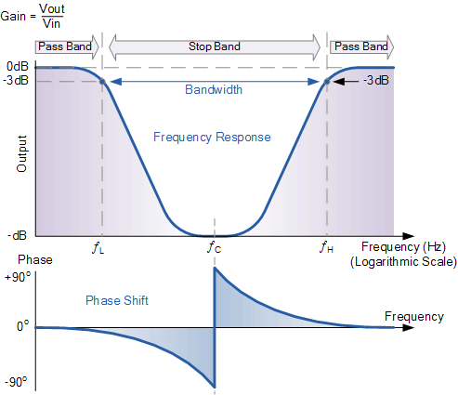
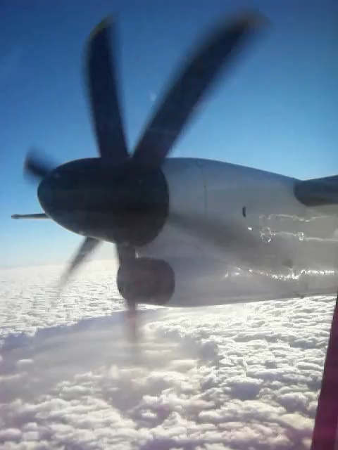
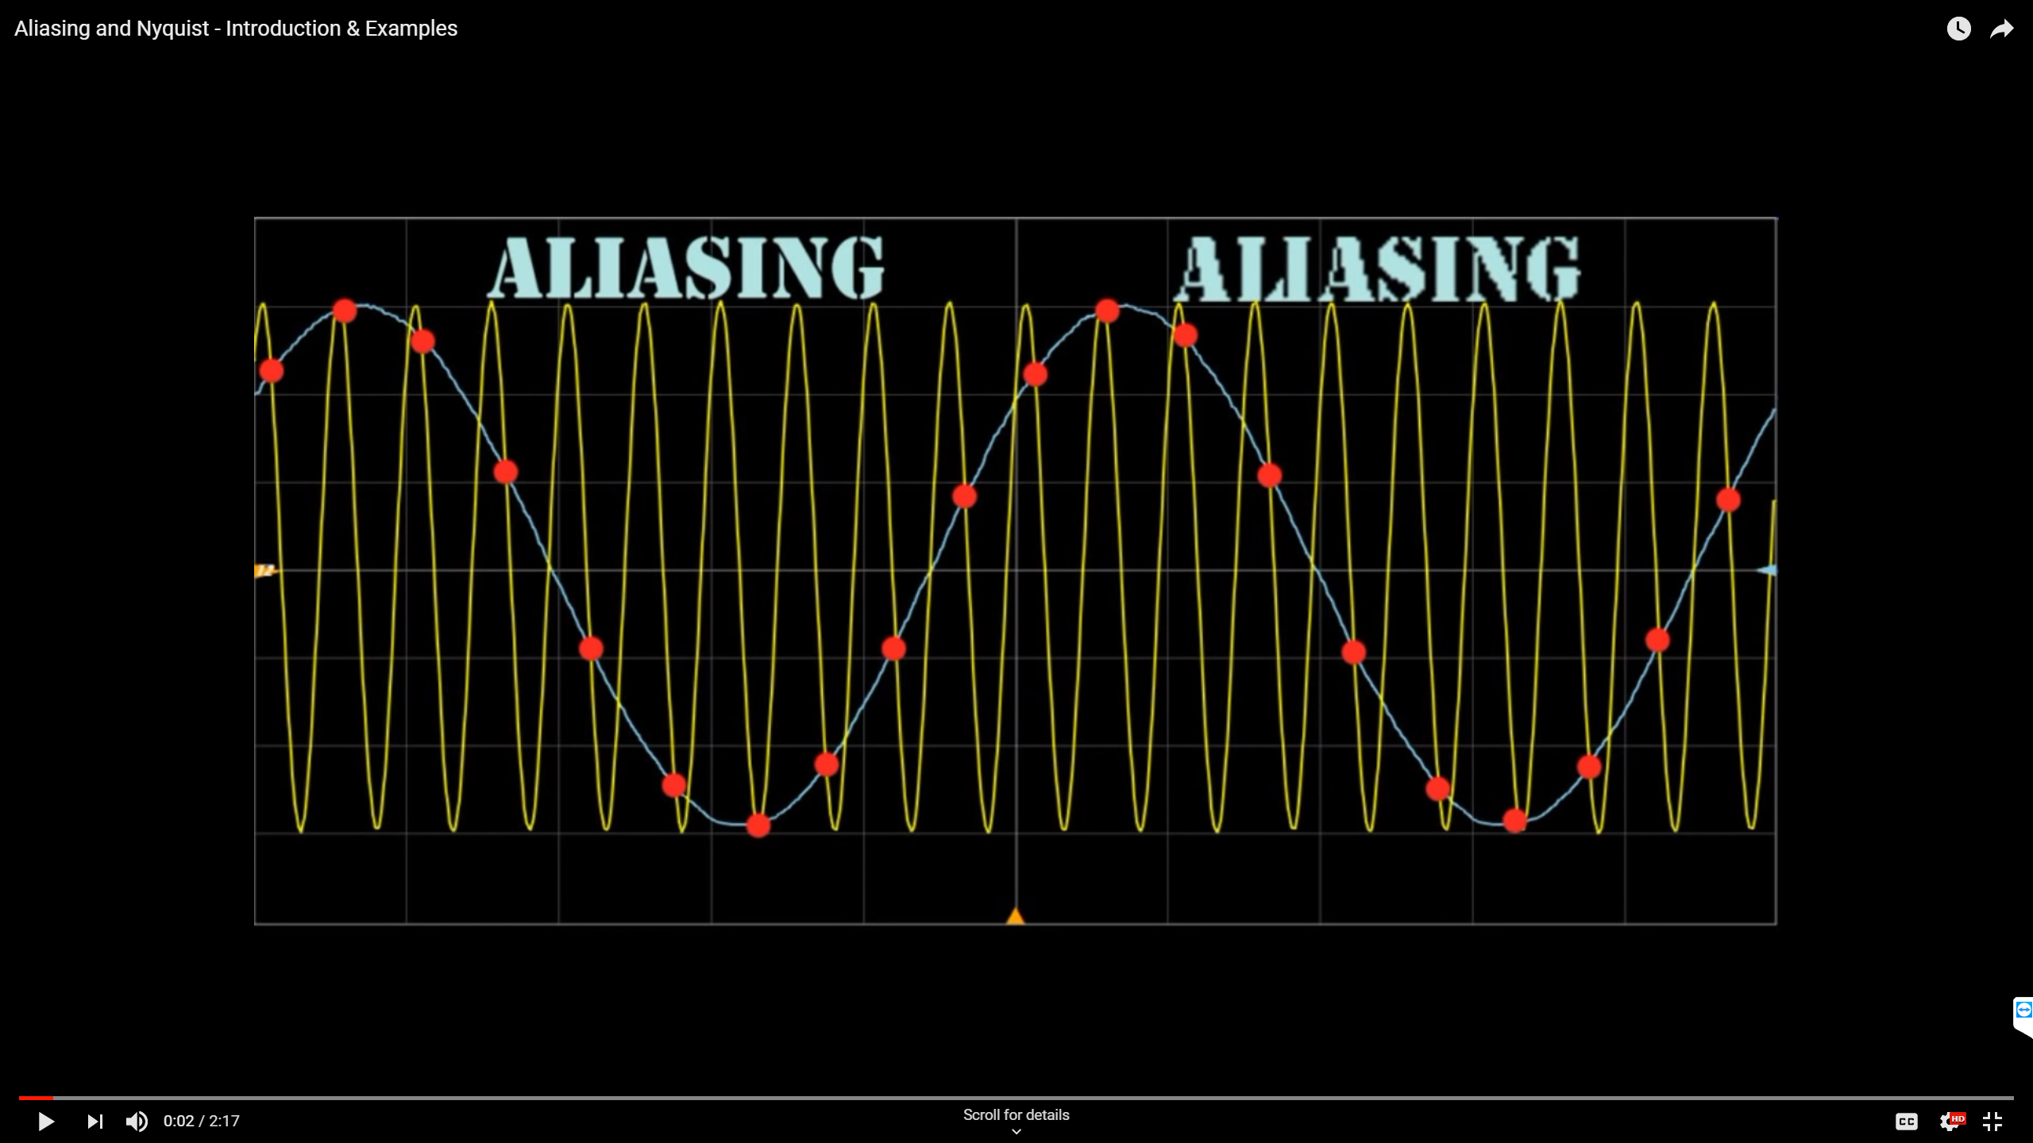
Aliasing, Sampling & Nyquist theorem
low sampling rate in fMRI (typically TR>1s) → Aliasing of cardiac pulsatility artifacts ($f_{c}≈1Hz$)
Wagon-wheel effect (stagecoach-wheel effect, stroboscopic effect):
Optical illusion in which a spoked wheel appears to rotate differently from its true rotation
However, methods in time-domain (e.g. RETROICOR) can correct for this source of noise:
RETROICOR (Glover et al. 2000) – based on Fourier series
Cardiac pulsatility model (Kassinopoulos et al. 2017) – dynamic linear model

Slide 12
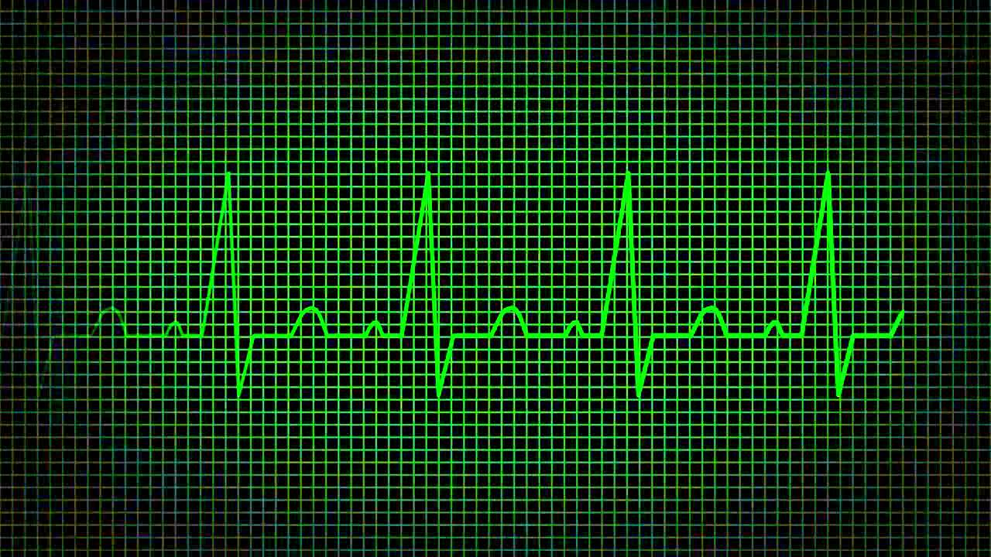
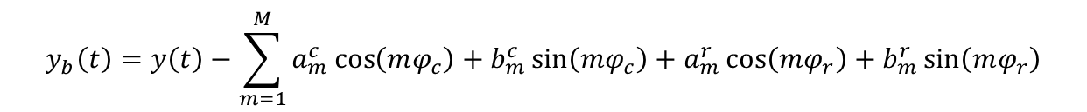
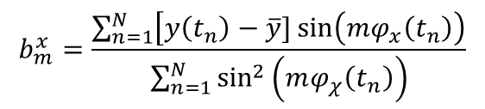
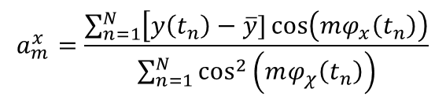
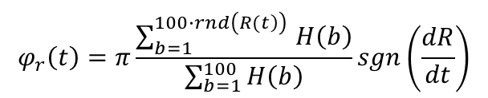
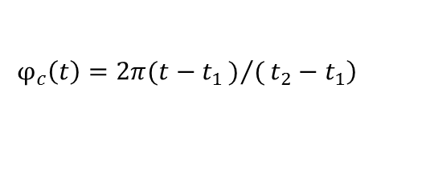
RETROICOR (RETROspective Image CORrection) - Glover et al. 2000
Assumption: The cardiac and respiratory artifacts in a voxel timeseries are quasi-periodic.
Whatever remains → brain activity
$$\left.φ_{c}\left(t\right)=2π(t−t_{1})/(t_{2}−t_{1}\right)$$
$$a_{m}^{x}=\frac{\sum_{n=1}^{N}{\left[y\left(t_{n}\right)−\overline{y}\right.}]\cos\left(mφ_{x}\left(t_{n}\right)\right)}{\sum_{n=1}^{N}{\cos^{2}\left(mφ_{χ}\left(t_{n}\right)\right)}}$$
$$φ_{r}\left(t\right)=π\frac{\sum_{b=1}^{100∙rnd\left(\left.R(t\right)\right) }{H\left(b\right)}}{\sum_{b=1}^{100}{H\left(b\right)}}sgn\left(\frac{dR}{dt}\right)$$
$$b_{m}^{x}=\frac{\sum_{n=1}^{N}{\left[y\left(t_{n}\right)−\overline{y}\right.}]\sin\left(mφ_{x}\left(t_{n}\right)\right)}{\sum_{n=1}^{N}{\sin^{2}\left(mφ_{χ}\left(t_{n}\right)\right)}}$$
ECG
“Brain activity”
$$y_{b}\left(t\right)=y\left(t\right)−\sum_{m=1}^{M}{a_{m}^{c}\cos\left(mφ_{c}\right)+b_{m}^{c}\sin\left(mφ_{c}\right)+a_{m}^{r}\cos\left(mφ_{r}\right)+b_{m}^{r}\sin\left(mφ_{r}\right)}$$

Slide 13
Steps for RETROICOR
RETROICOR order N: 2
Estimation of cardiac artifact:
Find peaks (R-waves) in PPG (or ECG) and estimate cardiac phase
Construct sinusoids based on the cardiac phase
Discretize sinusoids at TR intervals
Find linear combination of sinusoids that gives the best fit to the voxel timeseries
TR
TR
TR
TR
TR
TR

Slide 14
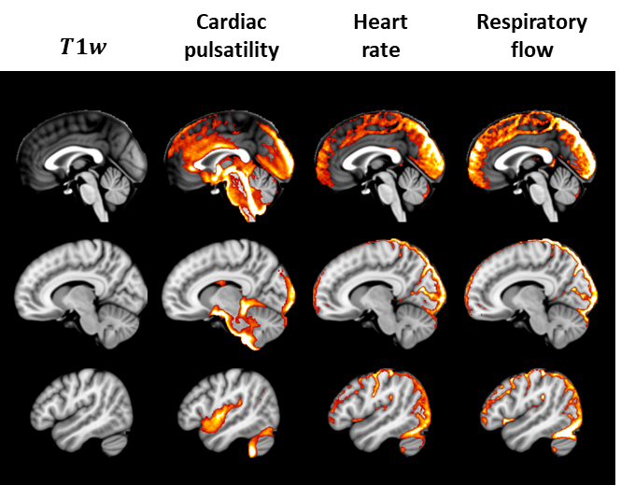
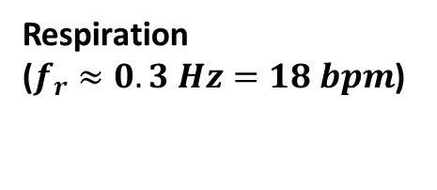
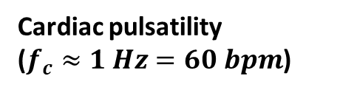
(High-frequency) Cardiac and respiratory artifacts identified by RETROICOR
TR=0.72s → signals with frequency above 0.7 Hz (e.g. cardiac pulsatility) are aliased
Cardiac pulsatility
($f_{c}≈1 Hz=60 bpm$)
Respiration
($f_{r}≈0.3 Hz=18 bpm$)

Slide 15
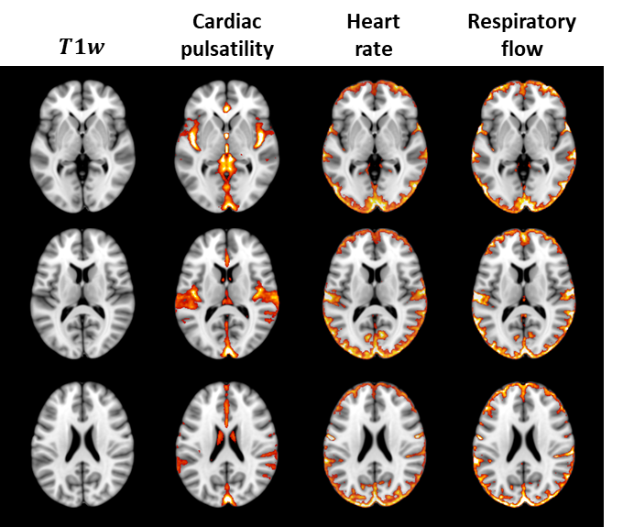
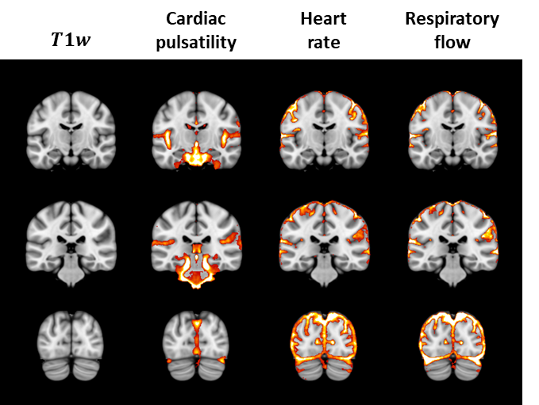
Contribution of different sources of physiological fluctuations
(Kassinopoulos & Mitsis, 2019, under revision)

